Slide 1

Connectivism
Stephen Downes
April 27, 2021
https://www.downes.ca/presentation/547

Slide 2
Outline
What is connectivism?
How Does Learning Occur?
Interpreting Connectivism

Slide 3
1. What is Connectivism?

Slide 4
What is Learning?
A change in human disposition or capability (Gagne)
A change in a person’s knowledge or behavior due to experience (Mayer)
A transformative process of taking in information (Bingham & Conner)
The acquisition and mastery of what is already known about something (Smith)
Acquiring knowledge and skills and having them readily available (Brown, et.al.)
Notes:
https://theelearningcoach.com/learning/10-definitions-learning/

Slide 5
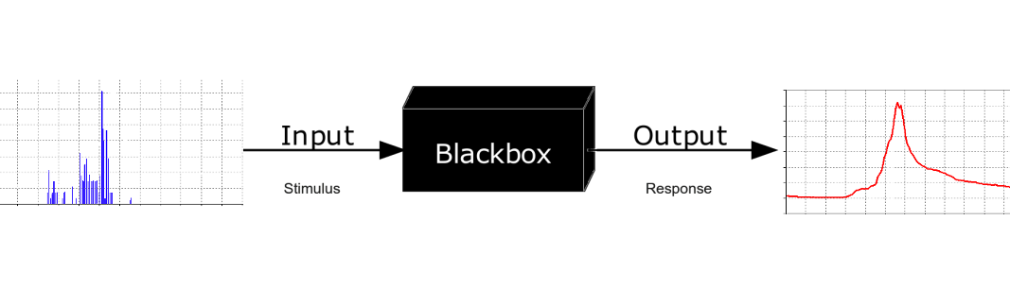
Black Box Theories
Connectivism seeks to look inside the black box to see exactly what is happening
It seeks to describe the physical (chemical and biological) processes that underlie learning

Slide 6
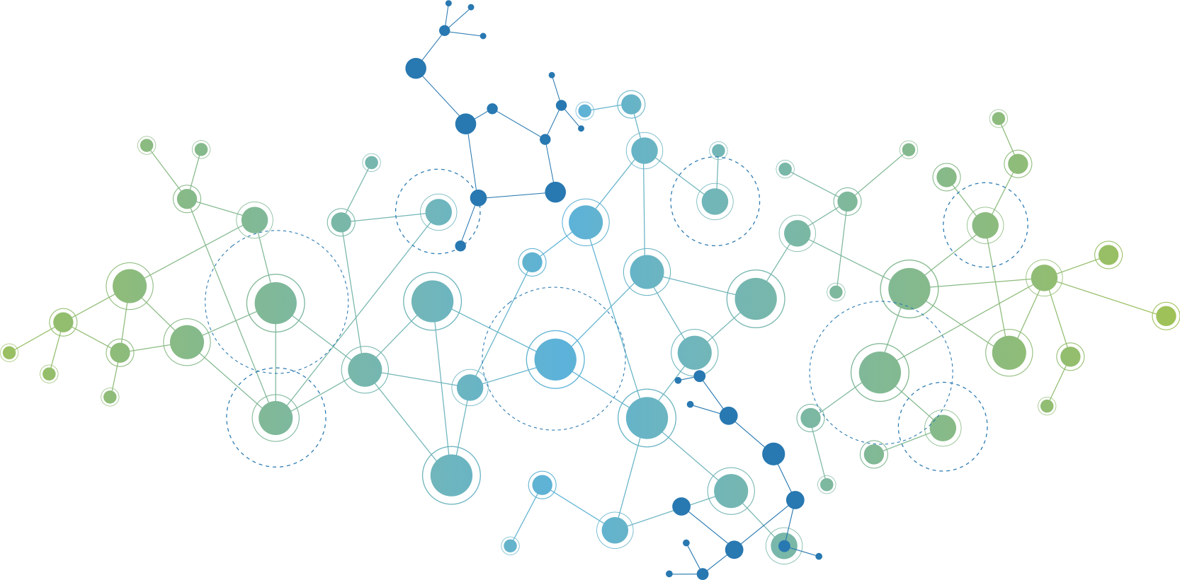
What Is Connectivism?
Connectivism is the thesis that knowledge is distributed across a network of connections, and therefore that learning consists of the ability to construct and traverse those networks.
Notes:
Downes, S. (2007) What Connectivism Is. https://www.downes.ca/post/38653

Slide 7
Connectivist Account of Learning
When I say of connectivism that 'learning is the formation of connections in a network' I mean this quite literally.
The sort of connections I refer to are between entities (or, more formally, 'nodes’).
I define a connection as follows (other accounts may vary): "A connection exists between two entities when a change of state in one entity can cause or result in a change of state in the second entity.“
Notes:
As you can see, connectivism says that learning is something very different from what is described in other theories. This is one reason we say connectivism is a learning theory: the vocabulary of learning it employs is in some ways importantly incommensurate with that of other theories.
When I say of connectivism that 'learning is the formation of connections in a network' I mean this quite literally. The sort of connections I refer to are between entities (or, more formally, 'nodes'). They are not (for example) conceptual connections in a concept map. A connection is not a logical relation. It is something quite distinct.
In particular, I define a connection as follows (other accounts may vary): "A connection exists between two entities when a change of state in one entity can cause or result in a change of state in the second entity."
Why is this important? Because it captures the idea that connections are something that we can observe and measure (they're not a black box), and because it captures the idea that networks are not merely structures, but also that they enable (what might be called) signalling between entities.
https://halfanhour.blogspot.com/2014/04/connectivism-as-learning-theory.html

Slide 8
What is It To Learn?
‘Learning’ is a thing that networks do, and consists specifically of some or all of the following:
  Addition or subtraction of nodes
  Addition or subtraction of connections
    (These are known as ‘plasticity’)
  Changes in the properties of nodes or connections
Connectivism can also be thought of as a way of thinking and talking about this way of learning

Slide 9
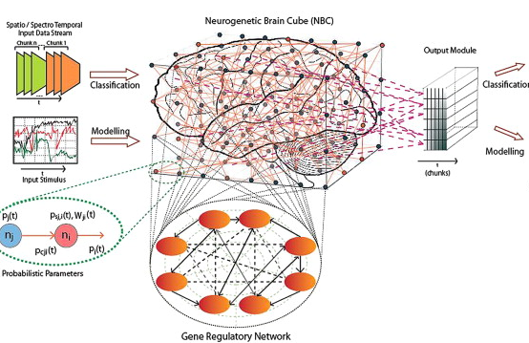
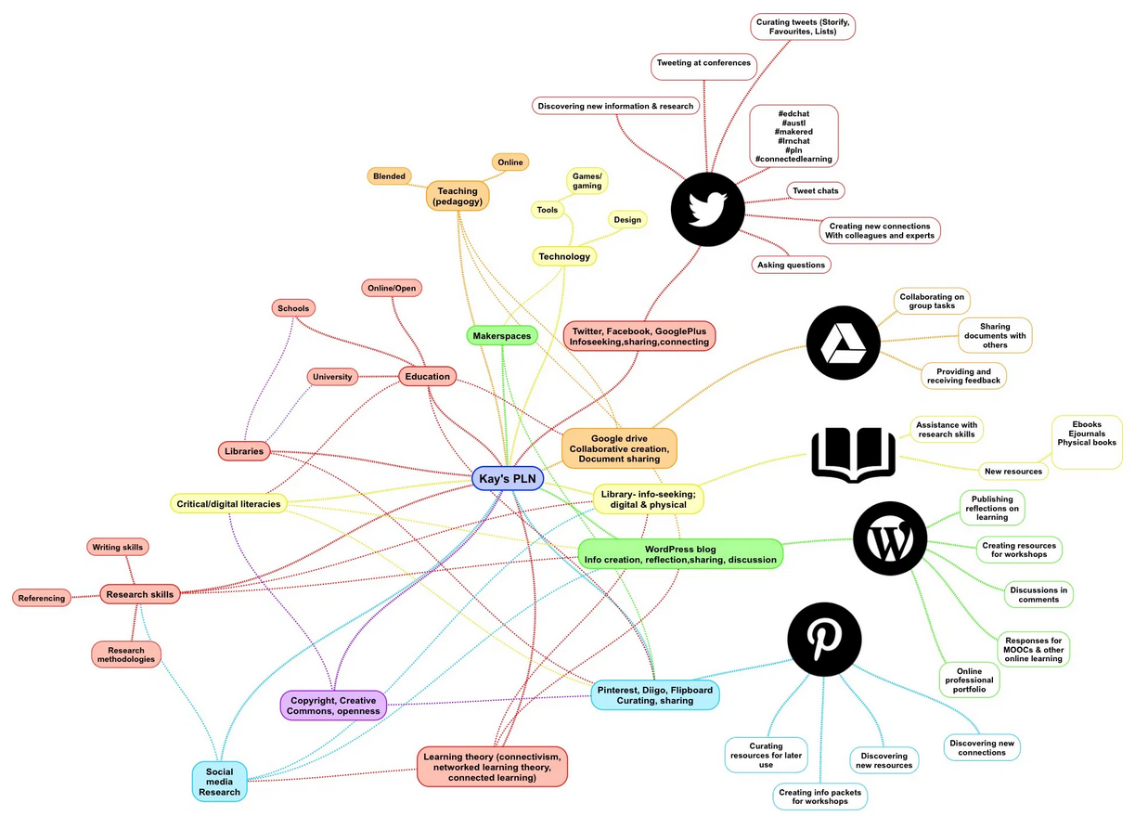
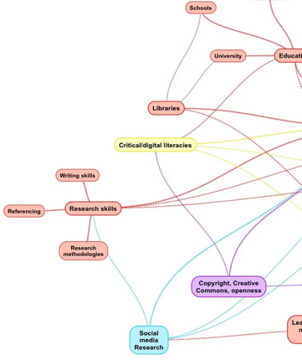
Things that Learn
Personal Learning Social Learning
(Polanyi) (Wittgenstein)
Notes:
https://www.linkinglearning.com.au/plns-theory-and-practice/
https://www.sciencedirect.com/science/article/abs/pii/S0893608014000070

Slide 10
George’s Principles
Learning and knowledge rest in a diversity of opinions.
Learning is a process of connecting specialized nodes or information sources.
Learning may reside in non-human appliances.
[The] capacity to know more is more critical than what is currently known.
Nurturing and maintaining connections is needed to facilitate continual learning.
[The] ability to see connections between fields, ideas, and concepts is a core skill.
Currency (accurate, up-to-date knowledge) is the intent of all connectivist learning activities.
Decision-making is a learning process.
Notes:
Siemens identified eight fundamental principles of connectivism:
Learning and knowledge rests [sic] in a diversity of opinions.
Learning is a process of connecting specialized nodes or information sources.
Learning may reside in non-human appliances.
[The] capacity to know more is more critical than what is currently known.
Nurturing and maintaining connections is needed to facilitate continual learning.
[The] ability to see connections between fields, ideas, and concepts is a core skill.
Currency (accurate, up-to-date knowledge) is the intent of all connectivist learning activities.
Decision-making is a learning process. Choosing what to learn and the meaning of incoming information is seen through the lens of a shifting reality. While there is a right answer now, it may be wrong tomorrow due to alterations in the information climate affecting the decision. (2004, “Connectivism,” para. 3)

Slide 11
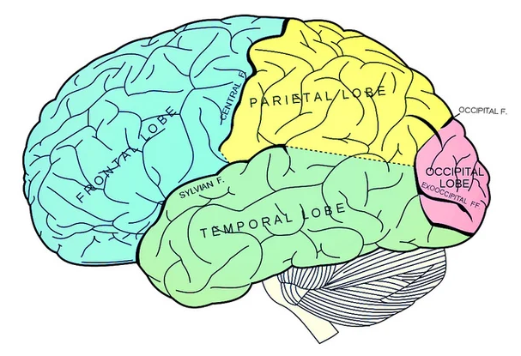
The Brain is not a Book or Library
Connectivism shares with some other theories a core proposition, that knowledge is not acquired, as though it were a thing.
This distinguishes it from content-based or information-theoretic theories of learning, like instructivist (Kirshener), and transactional distance (M.G. Moore) theories.
Notes:
https://www.scientificamerican.com/article/can-your-brain-really-be-full/

Slide 12
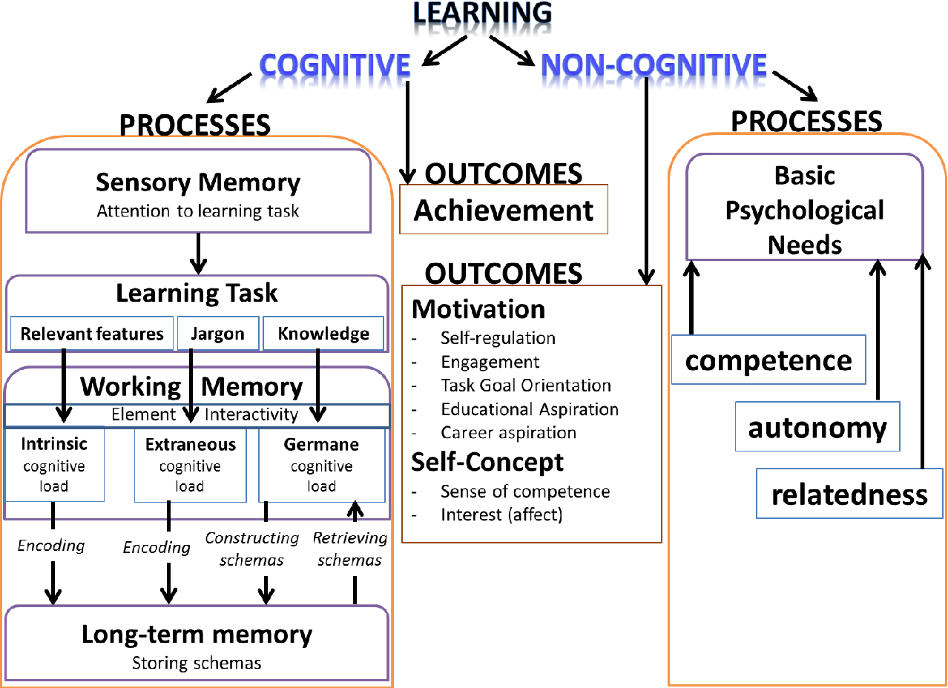
Connectivism is Non-Cognitivist
Notes:
Image: Kadir (2018). https://www.semanticscholar.org/paper/Enlightening-Science%3A-Addressing-the-Cognitive-and-Kadir/ba44e86aaef342568264b84e5eb5bb0ec6fc256a
Where connectivism differs from those theories, I would argue, is that connectivism denies that knowledge is propositional. That is to say, these other theories are 'cognitivist', in the sense that they depict knowledge and learning as being grounded in language and logic.
Connectivism is, by contrast, 'connectionist'. Knowledge is, on this theory, literally the set of connections formed by actions and experience. It may consist in part of linguistic structures, but it is not essentially based in linguistic structures, and the properties and constraints of linguistic structures are not the properties and constraints of connectivism.
In connectivism, a phrase like 'constructing meaning' makes no sense. Connections form naturally, through a process of association, and are not 'constructed' through some sort of intentional action. And 'meaning' is a property of language and logic, connoting referential and representational properties of physical symbol systems. Such systems are epiphenomena of (some) networks, and not descriptive of or essential to these networks.

Slide 13
The Brain is Not a Computer
What is it to 'construct an understanding' if it does not involve:
- a representational system, such as language, logic, images, or some other physical symbol set (ie., a semantics)
- rules or mechanisms for creating entities in that representational system (ie., a syntax)?
“Whereas computers do store exact copies of data – copies that can persist unchanged for long periods of time, even if the power has been turned off – the brain maintains our intellect only as long as it remains alive. There is no on-off switch. Either the brain keeps functioning, or we disappear.” – Epstein
Notes:
Robert Epstein. The Empty Brain.Aeon, 2018. https://aeon.co/essays/your-brain-does-not-process-information-and-it-is-not-a-computer?ref=eltbuzz
Connectivism is not a representational theory. It does not postulate the existence of physical symbols standing in a representational relationship to bits of knowledge or understandings. Indeed, it denies that there are bits of knowledge or understanding, much less that they can be created, represented or transferred.
This is the core of connectivism (and its cohort in computer science, connectionism). What you are talking about as 'an understanding' is (at a best approximation) distributed across a network of connections. To 'know that P' is (approximately) to 'have a certain set of neural connections'.
To 'know that P' is, therefore, to be in a certain physical state - but, moreover, one that is unique to you, and further, one that is indistinguishable from other physical states with which it is co-mingled.

Slide 14
Connectionism = non-representational
In connectivism, there is no real concept of transferring knowledge, making knowledge, or building knowledge.
The activities we undertake when we conduct practices in order to learn are more like growing or developing ourselves and our society in certain (connected) ways.
Notes:
The point is:
- there are no mental models per se (that is, no systematically constructed rule-based representational systems)
- and what there is (ie., connectionist networks) is not built (like a model) it is grown (like a plant)

Slide 15
2. How Does Learning Occur?

Slide 16
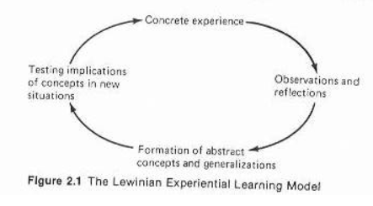
Overview
The question of how learning occurs is the question of how connections are formed between entities in a network. There is a deep and rich literature on this topic, under the heading of (not surprisingly) 'learning theory', though most of it is published outside the domain of education.
Kolb, 1984

Slide 17
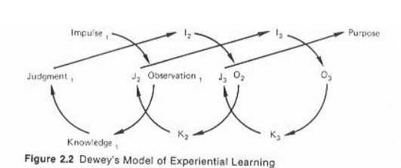
Overview
The question of how learning occurs is the question of how connections are formed between entities in a network. There is a deep and rich literature on this topic, under the heading of (not surprisingly) 'learning theory', though most of it is published outside the domain of education.
Kolb, 1984
Notes:
The question of how learning occurs is therefore the question of how connections are formed between entities in a network. There is a deep and rich literature on this topic, under the heading of (not surprisingly) 'learning theory', though most of it is published outside the domain of education. The first chapter available here provides a good overview.
The literature describes either actual networks of neurons ('neural networks', such as human or animal brains) or simulations of these networks ('artificial neural networks'), which are created using computers. In both cases, these networks 'learn' by automatically adjusting the set of connections between individual neurons or nodes.
This is a very different model of learning from that proposed by other learning theories.
In behaviourism, learning takes place through operant conditioning, where the learner is presented with rewards and consequences.
In instructivism, the transfer of knowledge takes place through memorization and rote. This is essentially a process of presentation and testing.
In constructivism, there is no single theory describing how the construction of models and representations happens - the theory is essentially the proposition that, given the right circumstances, construction will occur.
To be fair, a long discussion here would be required to talk about constructivist accounts of model or representation formation. This is a weakness of constructivist theories - there's no particular means to determine which constructivist theory is actually correct.
https://halfanhour.blogspot.com/2014/04/connectivism-as-learning-theory.html
Image: https://www.ocf.berkeley.edu/~jfkihlstrom/GSI_2011.htm
Kolb: https://www.researchgate.net/publication/235701029_Experiential_Learning_Experience_As_The_Source_Of_Learning_And_Development

Slide 18
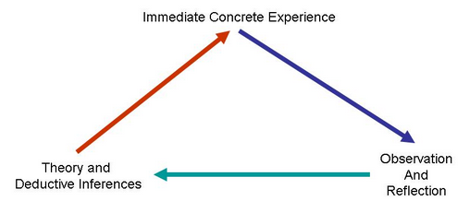
Overview
The question of how learning occurs is the question of how connections are formed between entities in a network. There is a deep and rich literature on this topic, under the heading of (not surprisingly) 'learning theory', though most of it is published outside the domain of education.
Kolb, 1984
Notes:
The question of how learning occurs is therefore the question of how connections are formed between entities in a network. There is a deep and rich literature on this topic, under the heading of (not surprisingly) 'learning theory', though most of it is published outside the domain of education. The first chapter available here provides a good overview.
The literature describes either actual networks of neurons ('neural networks', such as human or animal brains) or simulations of these networks ('artificial neural networks'), which are created using computers. In both cases, these networks 'learn' by automatically adjusting the set of connections between individual neurons or nodes.
This is a very different model of learning from that proposed by other learning theories.
In behaviourism, learning takes place through operant conditioning, where the learner is presented with rewards and consequences.
In instructivism, the transfer of knowledge takes place through memorization and rote. This is essentially a process of presentation and testing.
In constructivism, there is no single theory describing how the construction of models and representations happens - the theory is essentially the proposition that, given the right circumstances, construction will occur.
To be fair, a long discussion here would be required to talk about constructivist accounts of model or representation formation. This is a weakness of constructivist theories - there's no particular means to determine which constructivist theory is actually correct.
https://halfanhour.blogspot.com/2014/04/connectivism-as-learning-theory.html
Image: https://www.ocf.berkeley.edu/~jfkihlstrom/GSI_2011.htm

Slide 19
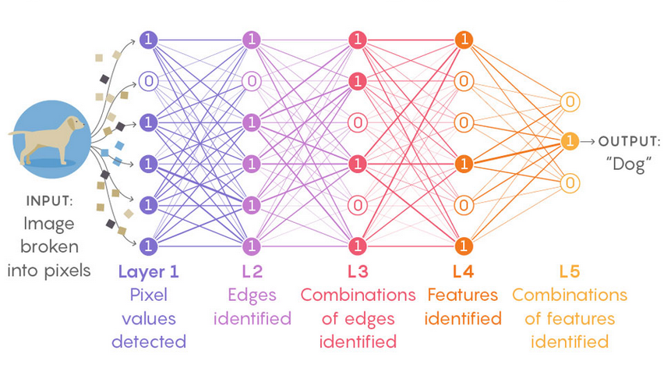
Neural Networks
Notes:
https://www.quantamagazine.org/new-theory-cracks-open-the-black-box-of-deep-learning-20170921/

Slide 20
George’s Networks
George Siemens describes networks as having the following characteristics or elements:
Content (data or information)
Interaction (tentative connection forming)
Static nodes (stable knowledge structure)
Dynamic nodes (continually changing based on new information and data)
Self-updating nodes (nodes which are tightly linked to their original information source)
Emotive elements (emotions that influence the prospect of connection and hub formations).
Notes:
From Siemens, 2005: https://web.archive.org/web/20051226233003/http://www.elearnspace.org/Articles/networks.htm
Siemens introduced the idea of networked learning, that is, learning as a process of network creation. A network consists of two basic elements: nodes and connections. Siemens defined a node as “any element that can be connected to any other element” and a connection as “any type of link between nodes” (2005, p. 5). As he explains, “Virtually any element that we can scrutinize or experience can become node. Thoughts, feelings, interactions with others, and new data and information can be seen as nodes. The aggregation of these nodes results in a network” (2005, p. 6). More specifically, he described networks as having the following characteristics or elements:
Content (data or information)
Interaction (tentative connection forming)
Static nodes (stable knowledge structure)
Dynamic nodes (continually changing based on new information and data)
Self-updating nodes (nodes which are tightly linked to their original information source, resulting in a high level of currency, i.e., up to date)
Emotive elements (emotions that influence the prospect of connection and hub formations). (2005, p. 7)
According to Siemens, the connections within a network are strengthened by emotion, motivation, exposure, patterning, logic, and experience. All of these nodes and connections are influenced by socialization and technology.
https://read.aupress.ca/read/teaching-health-professionals-online/section/157a9ad3-a0b2-4400-a946-d71d97ab63b7

Slide 21
Categories of Learning Theory
In my talks I've presented four major categories of learning theory
Hebbian rules - 'what fires together wires together'
Contiguity - neurons that are located near each other connect
Back Propagation - signals sent in reverse direction through a network, aka 'feedback', modify connections created by forward propagated signals
Boltzmann - networks seek to attain the lowest level of kinetic energy
The actual physical descriptions of these theories vary from network to network.
Notes:
In my talks I've presented four major categories of learning theory which describe, specifically and without black boxes, how connections are formed between entities in a network:
Hebbian rules - 'what fires together wires together' - neurons that frequently share the same state then to form connections between each other
Contiguity - neurons that are located near to each other tend to form connections, creatinhg a clustering effect
Back Propagation - signals sent in reverse direction through a network, aka 'feedback', modify connections created by forward propagated signals
Boltzmann - networks seek to attain the lowest level of kinetic energy
The actual physical descriptions of these theories vary from network to network - in human neurons, it's a set of electrical-chemical reactions, in social networks, it's communications between individual people, on computer networks it's variable values sent to logical objects.
These are the actual learning theories. Connectivism essentially collects these theories together into a single package as a mechanism for explaining how connections are formed in a network.

Slide 22
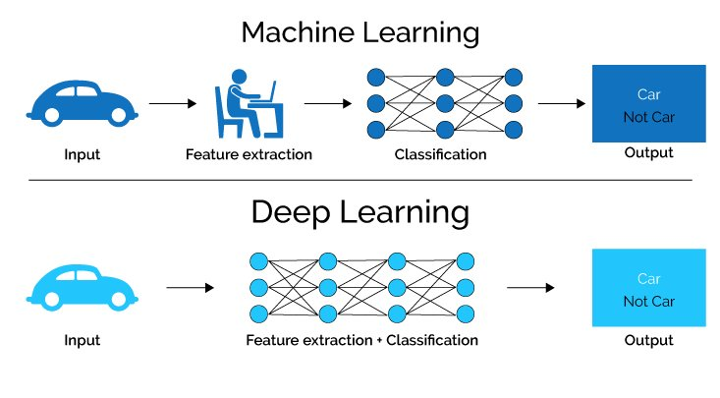
Machine & Deep Learning
Notes:
https://www.analyticsvidhya.com/blog/2020/02/cnn-vs-rnn-vs-mlp-analyzing-3-types-of-neural-networks-in-deep-learning/

Slide 23
Successful Networks
Notes:
This implies a pedagogy that (a) seeks to describe 'successful' networks (as identified by their properties, which I have characterized as diversity, autonomy, openness, and connectivity) and (b) seeks to describe the practices that lead to such networks, both in the individual and in society (which I have characterized as modeling and demonstration (on the part of a teacher) and practice and reflection (on the part of a learner)).

Slide 24
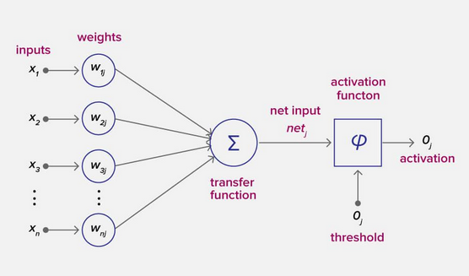
Properties of networks
Properties of Neurons
https://serokell.io/blog/deep-learning-and-neural-network-guide
Notes:
Basic Elements​
Entities​
The things that are connected​
Sends and receives signals​
Connections​
Link between entities – may be link, channel, etc​
May be represented as physical or virtual​
Signals ​
Message sent between entities - physical​
Meaning not inherent in signal, must be interpreted​
Some Properties of Networks​
Density​
how many other entities each entity is connected to ​
Speed​
How quickly a message moves to an entity​
Can be measured in ‘hops’​
Flow ​
How much information an entity processes​
Includes messages sent, received plus transfers​
Plasticity​
How frequently connections created, abandoned​
Satructure (e.g., layers, convolutions)
Diagram: https://www.analyticsvidhya.com/blog/2020/02/cnn-vs-rnn-vs-mlp-analyzing-3-types-of-neural-networks-in-deep-learning/

Slide 25
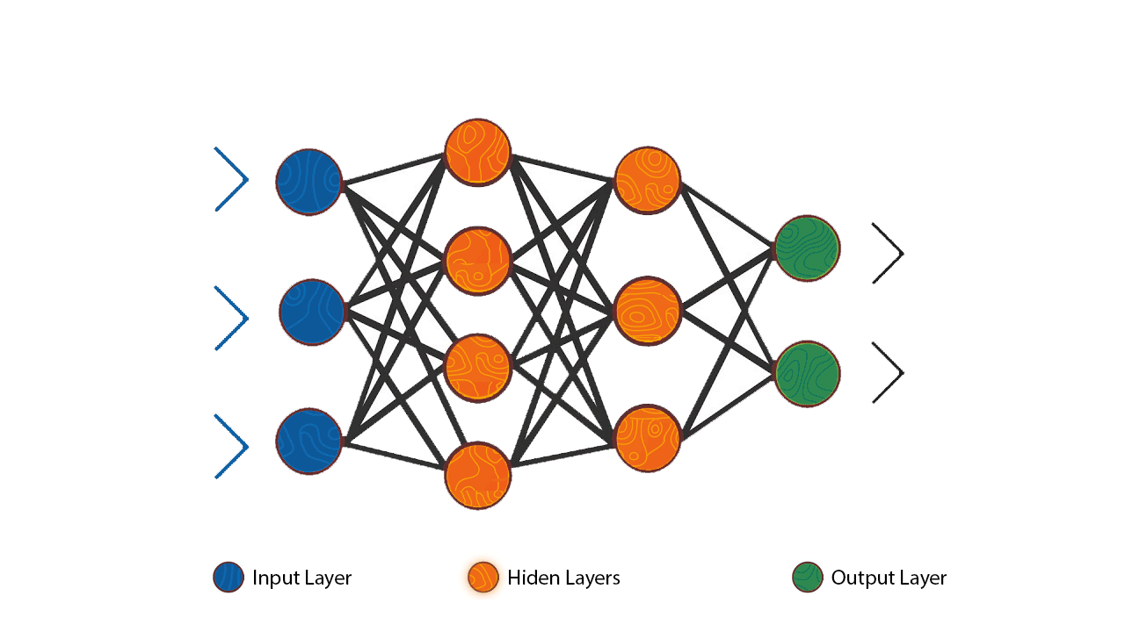
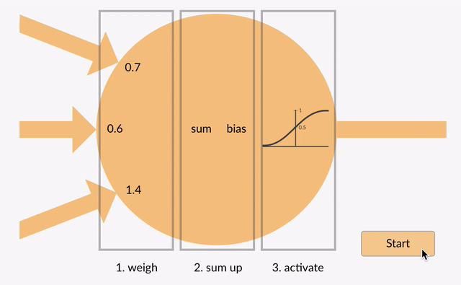
Properties of networks
Feed-Forward Neural Network (Perceptron) (ANN)
ANN can be used to solve problems related to:
Tabular data
Image data
Text data
The network only learns the linear function and can never learn complex relationships.

Slide 26
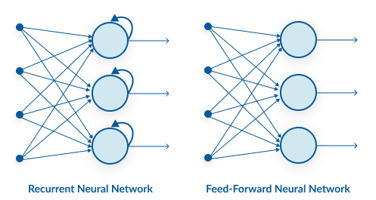
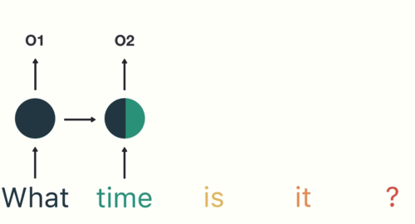
Properties of networks
Recurrent Neural Network (RNN)
We can use recurrent neural networks to solve the problems related to:
Time Series data
Text data
Audio data
Notes:
https://www.analyticsvidhya.com/blog/2020/02/cnn-vs-rnn-vs-mlp-analyzing-3-types-of-neural-networks-in-deep-learning/
See also: https://www.digitalvidya.com/blog/types-of-neural-networks/
https://analyticsindiamag.com/6-types-of-artificial-neural-networks-currently-being-used-in-todays-technology/

Slide 27
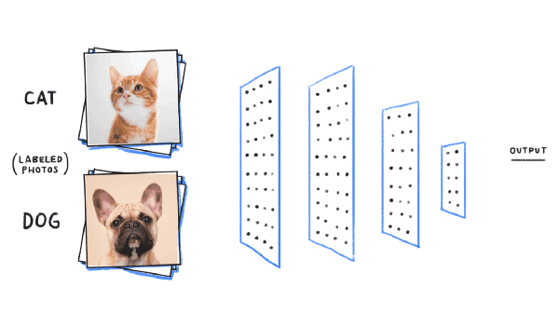
Properties of networks
Convolution Neural Network (CNN)
Properties of networks
CNN captures the spatial features from an image. Spatial features refer to the arrangement of pixels and the relationship between them in an image.
Notes:
https://www.analyticsvidhya.com/blog/2020/02/cnn-vs-rnn-vs-mlp-analyzing-3-types-of-neural-networks-in-deep-learning/

Slide 28
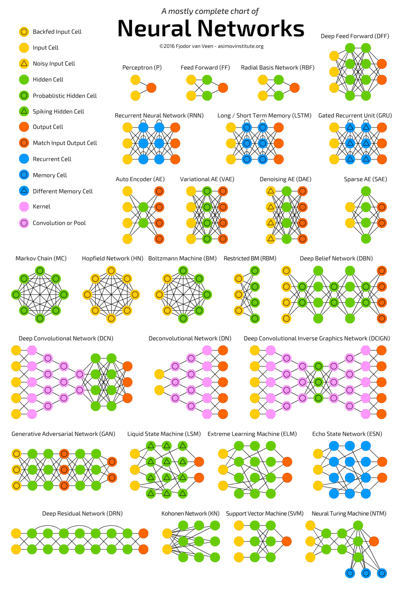
Even More Networks
Notes:
https://miro.medium.com/max/1000/1*cuTSPlTq0a_327iTPJyD-Q.png

Slide 29
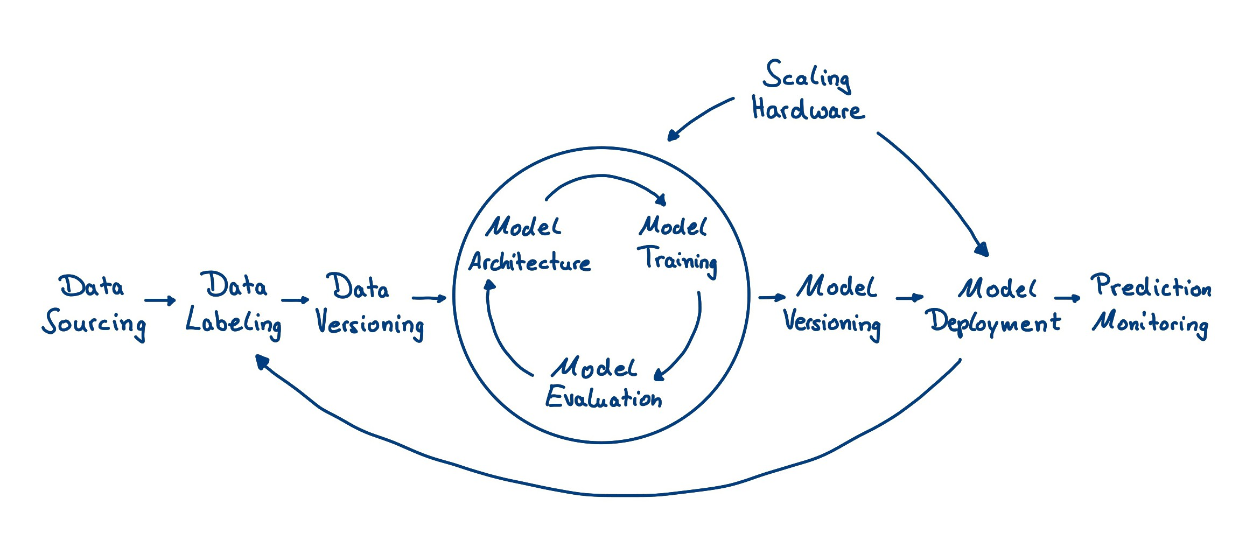
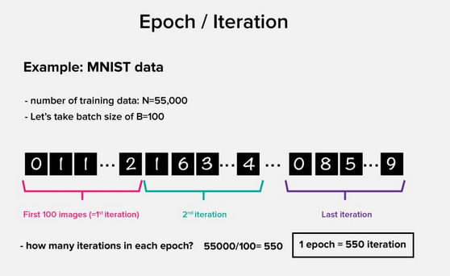
Training
Notes:
https://serokell.io/blog/deep-learning-and-neural-network-guide
Iteration
This is a kind of counter that increases every time the neural network goes through one training set. In other words, this is the total number of training sets completed by the neural network.
Epoch
The epoch increases each time we go through the entire set of training sets. The more epochs there are, the better is the training of the model.
Batch
Batch size is equal to the number of training examples in one forward/backward pass. The higher the batch size, the more memory space you’ll need.
What is the difference between an iteration and an epoch?
Error is a deviation that reflects the discrepancy between expected and received output. The error should become smaller after every epoch. If this does not happen, then you are doing something wrong.
The error can be calculated in different ways, but we will consider only two main ways: Arctan and Mean Squared Error.
There is no restriction on which one to use and you are free to choose whichever method gives you the best results. But each method counts errors in different ways:
With Arctan, the error will almost always be larger.
arctan2(i1−a1)+...+arctan2(in−an)n MSE is more balanced and is used more often.
(i1−a1)2+(i2−a2)2+...+(in−an)2
A typical deep learning lifecycle © 2018 Luminovo - https://www.kdnuggets.com/2019/03/deep-learning-toolset-overview.html

Slide 30
Network Design Principles
  Specifies how networks differ from traditional learning
  The idea is that each principle confers an advantage over non-network systems
  Can be used as a means of evaluating new technology
Notes:
Learning networks – theory and practice https://1drv.ms/p/s!AsfGmzWExt_wgYojJcUnYFduT8L_Fg?e=R1t5Qa

Slide 31
Decentralize
  Centralized networks have a characteristic ‘star’ shape
    Some entities have many connections
    The vast majority have few
    Eg., broadcast network, teacher in a classroom
  Decentralized networks form a mesh
    The weight of connections, flow is distributed
    Balanced load = more stable
    Foster connections between entities, ‘fill out’ the star

Slide 32
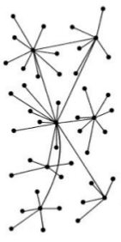
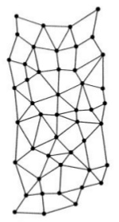

Groups vs Networks

Slide 33
Distribute
  Network entities reside in different physical locations
    Reduces risk of network failure
    Reduces need for major infrastructure, such as powerful servers, large bandwidth, massive storage
  Examples:
    Peer-to-peer networks, such as Kazaa, Gnutella
    Content syndication networks, such as RSS
  Emphasis is on sharing, not copying
    ‘Local’ copies are temporary

Slide 34
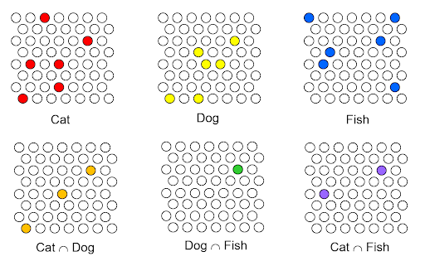
Distributed Representation
Notes:
The Classical Realization of Quantum Parallelism http://brainworkshow.sparsey.com/tag/sparse-distributed-representations/

Slide 35
Disintermediate
  Mediation – barrier between source and receiver
  Examples:
    Editors, peer review prior to publication
    Traditional media, broadcasters
    Teachers between knowledge and student
  Where possible, provide direct access
    The purpose of mediation is to manage flow, not information
    It is to reduce the volume of information, not the type of information

Slide 36
Disaggregate
  Units of content should be as small as possible
    Content should not be ‘bundled’
    Organization, structure created by receiver
    Allows integration of new information with old
  This is the idea behind learning objects
    smallest possible unit of instruction
    Assembling into pre-packaged ‘courses’ defeats this

Slide 37
Dis-integrate
  Entities in a network are not ‘components’ of one another
    Thus., eg. Plug-ins or required software to be avoided
  The structure of the message is logically distinct from the type of entity sending or receiving it
    The message is coded in a common ‘language’
    This code is open, not proprietary
    No particular software or device is needed to receive the code
  This is the idea of standards, but:
    Standards are not created, they evolve
    Standards adopted by agreement, not requirement

Slide 38
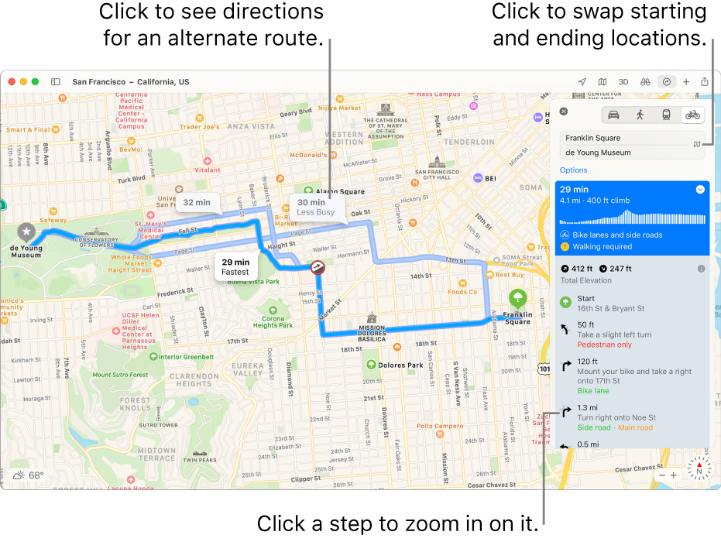
Maps vs Stories
Notes:
Image: https://www.youtube.com/watch?v=TuT8sA2NYus

Slide 39
Democratize
  Entities in a network are autonomous
    Have the freedom to negotiate connections
    Have the freedom to send, receive information
  Diversity is an asset
    Diversity confers flexibility, adaptation
    Diversity enables the network as a whole to represent more than just the part
  Control is Impossible
    Even where control seems desirable, it is not practical
    Creating control effectively destroys the network

Slide 40


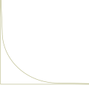
The Semantic Condition
Groups Networks
SAMENESS
AFFINITY
Collectives
Communities
ONE WAY
MANY WAYS
Metallic - Elemental
Organic - Biological
UNITY | DIVERSITY
COORDINATION | AUTONOMY
CLOSED | OPENNESS
DISTRIBUTIVE | INTERACTIVE
VISION
STATEMENT
SOMETIMES EVEN PURITY
MELTING POT
MIXTURES
SALAD BOWL
LEADERS! COLLABORATION
GROUP VALUE
(= LEADER VALUE)
COOPERATION
EXCHANGE
MUTUAL VA:UE
LOCK-IN
MEMBERSHIP / IN CAMERA
STANDARDS - JARGON
WALLS
CONNECTION
PERSPECTIVE / CONTEXT
BRIDGES
AKA
TRICKLE DOWN
BROADCAST
STARS AND GURUS
CENTRALIZED
POWER – POWER LAWS
CONVERSATION
DISTRIBUTED
DEMOCRACY (OR POST-DEMOCRACY)
KNOWLEDGE
EMERGES
RICH
KNOWLEDGE,
LIKE MONEY,
FLOWS FROM AUTHORITY
POOR
Notes:
https://www.downes.ca/presentation/477

Slide 41
Dynamize
  A network is a fluid, changing entity
    Without change, growth, adaptation are not possible
    It is through the process of change that new knowledge is discovered
  The creation of connections is a core function

Slide 42
Desegregate
  Example: Learning is not a Separate Domain
    Do not need learning-specific tools, processes
    Learning is a part of living, of work, of play
    The same tools we use to perform day-to-day activities are the tools we use to learn
  The Network as Infrastructure
    Computing, communicating, not something we ‘go some place to do’
    The idea of network resources as a utility, like electricity, like water, like telephones – the network is everwhere

Slide 43
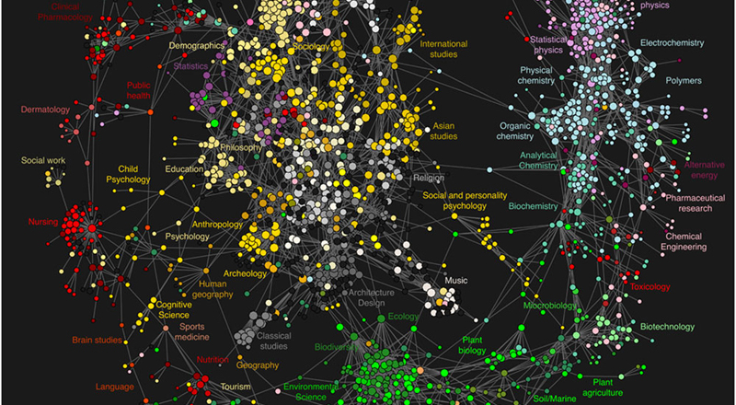
The Web of Science

Slide 44
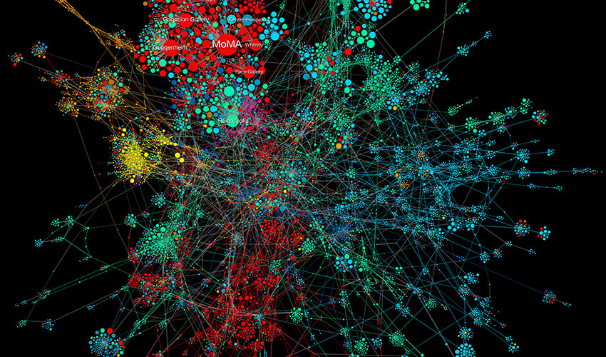
The Art Network
Notes:
The Art Network, BarabásiLab (2018) - https://www.clotmag.com/news/opening-hidden-pattern-visualising-networks-by-barabasilab-at-ludwig-museum-Budapest

Slide 45
3. Interpreting Connectivism

Slide 46
Parsimony
Network theory is established in multiple domains
  Foundation in mathematics, as graph theory
  Computer science – connectionism and neural networks
  Biology – ecology and ecosystems
  Sociology – social network analysis
  Physiology – perception, neuroscience
  Philosophy – information theory, distributed representation

Slide 47
Networks in the World
Networks in nature, such as the murmuration
Social organization, such as corporate networks, political networks
Infrastructure, such as the electrical grid
The internet, a worldwide information network
Social networks, such as discussion boards, web sites, Facebook, Twitter

Slide 48
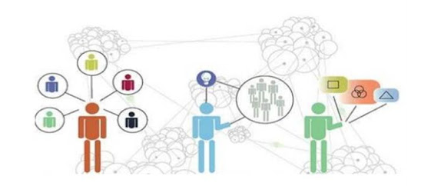
A Theory for the Digital Age
In December 2004, Siemens posted his first article on this new learning theory, “Connectivism: A Learning Theory for the Digital Age.” What does that mean?
Notes:
Connectivism has been described as a theory that “emphasizes the importance of non-human appliances, hardware and software, and network connections for human learning. The theory stresses the development of ‘metaskills’ for evaluating and managing information and network connections, and notes the importance of information pattern recognition as a learning strategy” (Couros, 2009, p. 233).
Connectivism, with its emphasis on knowing how to use technology to find needed information, to network, and to judge the relevance of information, is tailor-made for us. George Siemens, the founder of connectivism, could well have had the education of health professionals in mind when he wrote:
Learning occurs as a result of reflection on, and validation of, content . . . this process is most often initiated through interaction. In this model (and online), content is not less important. The difference is in how content is explored . . . and to a degree who provides it—teacher, student, or both. Effective teaching requires equipping students with the skills and beliefs to be able to provide for their own learning. (Siemens, 2002; ellipses in original)
https://read.aupress.ca/read/teaching-health-professionals-online/section/157a9ad3-a0b2-4400-a946-d71d97ab63b7

Slide 49
What is Knowledge?
Is it knowledge if the person memorizes the multiplication table or Pythagorean Theorem but never uses that information?

Slide 50
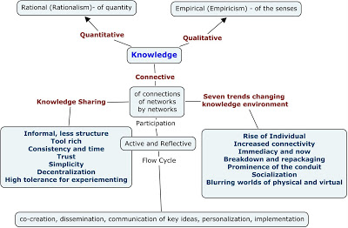
Three Types of Knowledge
Qualitative – based on figure or property
Quantitative – based on mass or quantity
Connective – based on organization or structure
Notes:
Image: http://teachweb2.blogspot.com/2008/09/cck08-knowledge-concept-map.html
Stephen Downes entered the connectivist discussion in a 2005 blog post, in which he argues that, in addition to qualitative and quantitative knowledge, we must include a third type in the domain of knowledge, which he called distributed, or connective, knowledge:
Distributed knowledge adds a third major category to this domain, knowledge that could be described as connective. A property of one entity must lead to or become a property of another entity in order for them to be considered connected; the knowledge that results from such connections is connective knowledge. (2005, sec. a, para. 2)
Furthermore, Downes stresses, “Connective knowledge requires an interaction. More to the point, connective knowledge is knowledge of the connection” (2005, sec. a, para. 6).
(Now this below is wrong – it’s not the same sort of ‘connective’ knowledge)
Distributive knowledge, or distributive cognition, is not new to the educational psychology literature. In 1998, the concept was reviewed by Hewett and Scardamalia, who discuss schooling as “communities grounded in the practice of knowledge building” (p. 75). In that early Internet era, these authors, citing Pea (1993), indicate an evolution over time in technology supporting distributed learning: “Textbooks, notebooks, rulers, the organization of desks, and the writing on blackboards and bulletin boards are seen as cultural artifacts that carry intelligence in them” (Pea, as cited in Hewett and Scardamalia, 1998, p. 76). https://read.aupress.ca/read/teaching-health-professionals-online/section/157a9ad3-a0b2-4400-a946-d71d97ab63b7

Slide 51
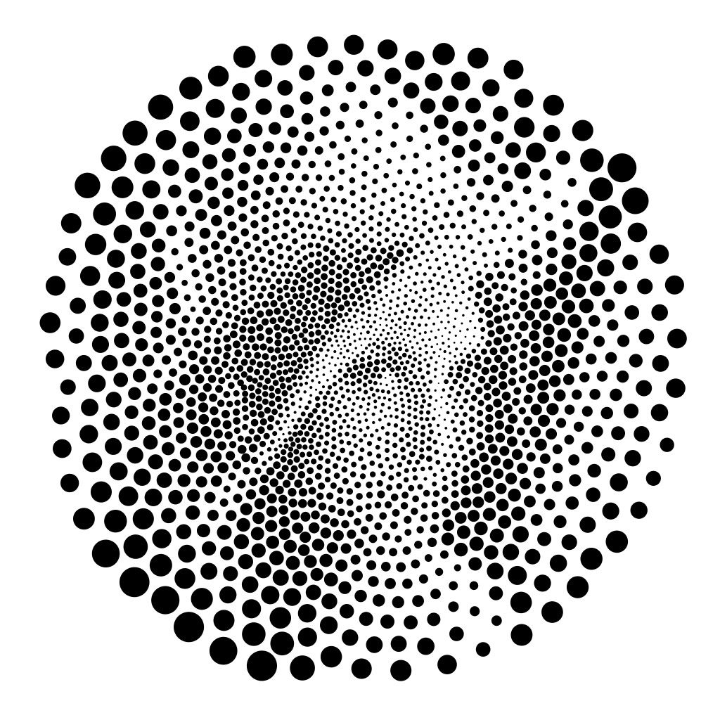
Emergence
Connective knowledge is emergent
Notes:
Image: https://www.pinterest.ca/pin/480266747747507347/

Slide 52
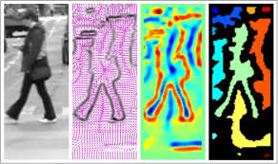
Knowledge as recognition
Knowledge is a network phenomenon. To ‘know’ something is to be organized in a certain way, to exhibit patterns of connectivity. To ‘learn’ is to acquire certain patterns. This is as true for a community as it is for an individual
Notes:
Image: https://www.facebook.com/SMUNAF82/
According to the theory of connectivism, learning is an activity that consists in forging connections and thus creating networks. Learning is ubiquitous, and it takes place continuously. It may result from deliberate action on the part of an individual, or it may occur in random or haphazard ways. However, as we saw, connectivism acknowledges “the importance of information pattern recognition as a learning strategy” (Couros 2009, p. 233). This pattern recognition can be actualized at the individual or group level; when the process occurs at the group level, the group becomes a networked community. As Stephen Downes puts it, “Knowledge is a network phenomenon. To ‘know’ something is to be organized in a certain way, to exhibit patterns of connectivity. To ‘learn’ is to acquire certain patterns. This is as true for a community as it is for an individual” (2006, “The Semantic Condition,” para. 1). https://read.aupress.ca/read/teaching-health-professionals-online/section/157a9ad3-a0b2-4400-a946-d71d97ab63b7

Slide 53
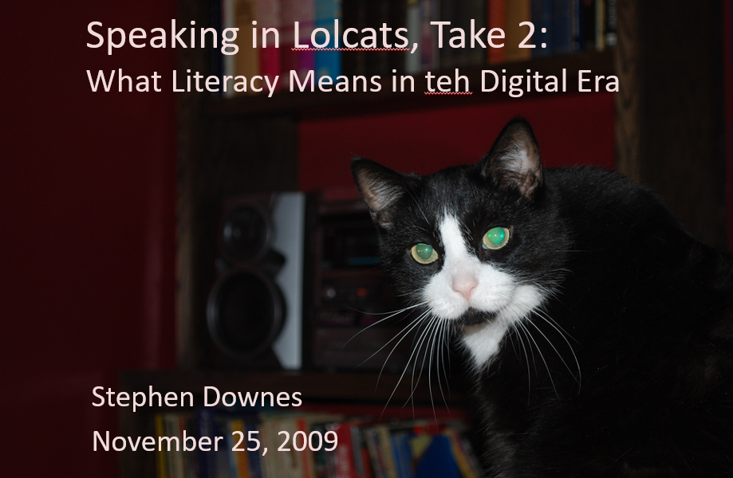
Literacy
A connectivist model of literacy isn’t about language, it’s about patterns.
In my 'Speaking in LOLcats' presentation, I propose a six-element connectivist account of literacy, one that also includes elements of cognition, context and change.
Notes:
Image: https://www.downes.ca/presentation/233
A connectivist view of the world is very different from one found in other theories.
For example, to the question what is knowledge a connectivist will talk about the capacity of a network to recognize phenomena based on partial information, a common property of neural networks.
Connectivism proposes therefore what might be called 'direct knowledge', following the work of people such as J.J. Gibson. This is very different from what might be called 'indirect knowledge', which is based on the creation of models or representations using an internal (and possible innate) language or logic.
Consequently, a connectivist account of literacy will be very different from that found in other theories. These theories are essentially language-based and are concerned with the coding and decoding of information in such a language. Major principles will revolve around syntax (aka grammar) and meaning and truth (aka semantics).
A connectivist account of literacy reinterprets both syntax and semantics, looking well beyond rules and meaning. In my 'Speaking in LOLcats' presentation, I propose a six-element connectivist account of literacy, one that also includes elements of cognition, context and change.
https://halfanhour.blogspot.com/2014/04/connectivism-as-learning-theory.html

Slide 54
Understanding new media
Morris, Derrida and a little Lao Tzu
Syntax | Cognition
Semantics | Context
Pragmatics | Change
We need this frame because (as Jukes said) if we aren’t looking for these things, we just won’t see them.

Slide 55
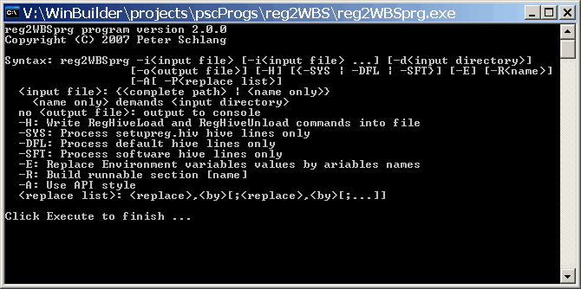
Syntax
Not just rules and grammar
Forms: archetypes? Platonic ideals?
Rules: grammar = logical syntax
Operations: procedures, motor skills
Patterns: regularities, substitutivity (eggcorns, tropes)
Similarities: Tversky - properties, etc

Slide 56
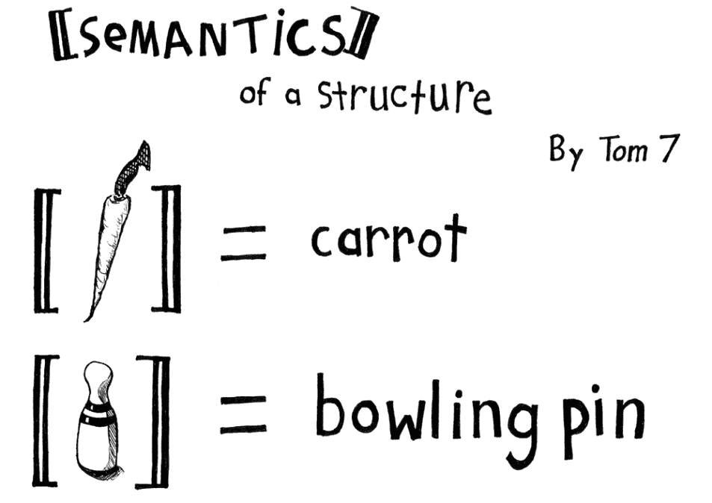
Semantics
theories of truth / meaning / purpose / goal
http://www.cs.cmu.edu/~tom7/csnotes/fall02/semantics.gif
- Sense and reference (connotation and denotation)
- Interpretation (Eg. In probability, Carnap - logical space; Reichenbach - frequency; Ramsey - wagering / strength of belief)
- Forms of association: Hebbian, contiguity, back-prop, Boltzmann
- Decisions and decision theory: voting / consensus / emergence

Slide 57
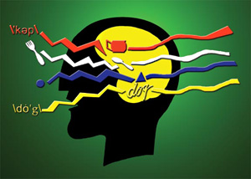
Pragmatics
use, actions, impact
Speech acts (J.L. Austin, Searle) assertives, directives, commissives, expressives, declarations (but also - harmful acts, harassment, etc)
Interrogation (Heidegger) and presupposition
Meaning (Wittgenstein - meaning is use)

Slide 58
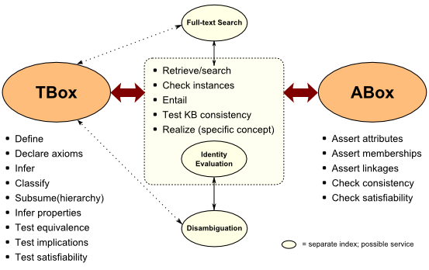
Cognition
reasoning, inference and explanation
http://www.mkbergman.com/category/description-logics/
  description - X (definite description, allegory, metaphor)
  definition - X is Y (ostensive, lexical, logical (necess. & suff conds), family resemblance - but also, identity, personal identity, etc
  argument - X therefore Y - inductive, deductive, abductive (but also: modal, probability (Bayesian), deontic (obligations), doxastic (belief), etc.)
  explanation - X because of Y (causal, statistical, chaotic/emergent)

Slide 59
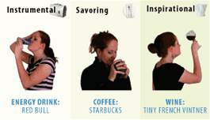
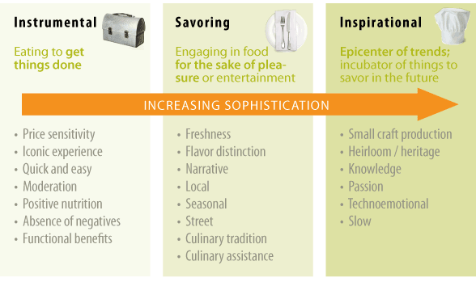
Context
placement, environment
http://www.occasionbasedmarketing.com/what-it-is
- explanation (Hanson, van Fraassen, Heidegger)
- meaning (Quine); tense - range of possibilities
- vocabulary (Derrida); ontologies, logical space
Frames (Lakoff) and worldviews

Slide 60
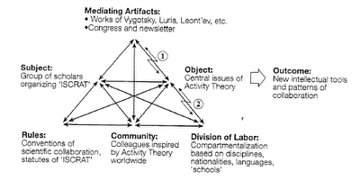
Change
relation and connection: I Ching, logical relation
flow: Hegel - historicity, directionality; McLuhan - 4 things
- progression / logic -- games, for example: quiz&points, branch-and-tree, database
- scheduling - timetabling - events; activity theory / LaaN

Slide 61
21st Century Languages
Languages Elements | Performance | Simulation | Appropriation
Syntax
Semantics
Pragmatics
Cognition
Context
Change

Slide 62
Example: Performance - Syntax
Languages Elements | Performance (the ability to adopt alternative identities for the purpose of improvisation and discovery)(subcategories?)
Syntax: - Forms - Rules - Operations - Patterns - Similarities | - Presentation acting, method acting - “Know your lines” etc http://filmtvcareers.about.com/od/gettingthejob/a/GJ_Actor_Tips.htm - Stanislavski’s system (etc…) http://en.wikipedia.org/wiki/Stanislavski%27s_system - Ritual Performance (etc.) http://www.let.rug.nl/koster/papers/JHP.Koster2.Edit.pdf - Comparing Tales (etc.) http://artsedge.kennedy-center.org/content/2343/

Slide 63
-
Notes:
Additionally, the question of how we evaluate learning in connectivism is very different. Rather than focus on rote response, or on manipulations inside a model, a connectivist model of evaluation involves the recognition of expertise by other participants inside the network.
In connectivism, the principles of quality educational design are based on the properties of networks that effectively respond to, and recognize, phenomena in the environment.In various works, I have identified these as autonomy, diversity, openness, and interactivity. These are very different from standard accounts of quality.
With each of these aspects of connectivism being identified and developed, it becomes increasingly apparent that a connectivist sees learning very differently from those who follow other theories.
They see a person learning as a self-managed and autonomous seeker of opportunities to create, interact and have new experiences, where learning is not the accumulation of more and more facts or memories, but the ongoing development of a richer and richer neural tapestry.
They understand that the essential purpose of education and teaching is not to produce some set of core knowledge in a person, but rather to create the conditions in which a person can become an accomplished and motivated learner in their own right.
https://halfanhour.blogspot.com/2014/04/connectivism-as-learning-theory.html
-
Assessment of connectivist learning is challenging when criteria traditionally used to assess and value learning are applied to judge whether a student has achieved an effective learning network. In health care education, students must be able not only to articulate what they know but also to provide relevant evidence from credible sources in order to support their professional decisions and actions.
Furthermore, as Siemens concludes, “the capacity to know is more critical than what is actually known” (2008, para. 6), and this is something for which traditional education has not developed assessment criteria. When they begin to think as connectivists, students and educators may need to undergo a paradigm shift in their beliefs about how online learning occurs and how it is measured.
https://read.aupress.ca/read/teaching-health-professionals-online/section/157a9ad3-a0b2-4400-a946-d71d97ab63b7

Slide 64
Evaluation of Learning

Slide 65
Community

Slide 66
Social learning
Notes:
A key feature of connectivism is that much learning can happen across peer networks that take place online. In connectivist learning, a teacher will guide students to information and answer key questions as needed, in order to support students learning and sharing on their own. Students are also encouraged to seek out information on their own online and express what they find. A connected community around this shared information often results.
https://www.learning-theories.com/connectivism-siemens-downes.html

Slide 69
4. Connectivism as Pedagogy
Notes:
Network Pedagogy​
Think of as ‘Network Pragmatics’​
Deals with how to use networks to support learning​
Embraces the idea of ‘distributed knowledge’​
Example: knowing how to build a 747​
‘I store my knowledge in my friends’​
Recognizes explicity that what we ‘know’ is embedded in our network of connections to each other, to resources, to the world​
George Siemens http://www.elearnspace.org/Articles/connectivism.htm​

Slide 70
Instructional theories
Bruner (1966) an instructional theory should deal with four major elements:
  (1) the learning predisposition,
  (2) the design of concepts to be presented and its structure for ease of understanding,
  (3) the most successful progression of ideas in which to present a body of knowledge, and
  (4) the administration of rewards and punishments.
This is not exactly the connectivist approach…
Notes:
An instructional theory, on the other hand, must prescribe procedures to enable learning efficiently and effectively. According to Bruner (1966) an instructional theory should deal with four major elements: (1) the learning predisposition, (2) the design of concepts to be presented and its structure for ease of understanding, (3) the most successful progression of ideas in which to present a body of knowledge, and (4) the administration of rewards and punishments. Therefore, an instructional theory focuses on the overall structure of learning material for the most successful learning experience. As a result of Bloom’s Taxonomy of Education Objectivesfrom 1956 (Bloom, 1984), instructionaltheory enabled the educator to code the learning process. This spawned a series of instructional theorists such as Robert Gagne, who published Conditions of Learningfor the Florida State University's Department of Educational Research (Gagne & Medsker, 1996).
From the late 1970s, instructional theory has been traditionally split into two categories: behaviorism and cognitivism. Skinner’s (Black, 1995) behaviorist theories were popular, because they could be evaluated using the new categorization kind ofprocess, whereas it was more difficult to demonstrate a cognitive learning result. In opposition, Paulo Freire’s Pedagogy of the Oppressed(2007) criticized the idea of an educational model being “banked”. Much like Bruner’s definition of instructional theory, Schott & Driscoll (1997) formulated a proposal for a universal instructional theory. Four components for an instructor and designer to consider were: (1) the learner, (2) the learning task, which includes learning outcome goals, (3) the conditions and instructional methods for learning, the overall environment, and (4) a frame of reference for specific learning. “Therefore, the purpose of instructional theory is to be prescriptive, to provide principles by which teachers and instructional designers can assure learning” (Driscoll, 2000, p. 353).Gagne more clearly defined instructional theory during World War II for the process of training pilots in the Air Force (Gagne & Medsker, 1996). He later developed a sequence of requirements that codify what educators should use for instruction. Gagne is considered to be the foremost researcher and contributor to the organized approach to instructional theory. Hismajor input to the theory of instruction was his model for "Nine Events of Instruction“
https://www.hetl.org/wp-content/uploads/2013/09/HETLReview2013SpecialIssueArticle1.pdf

Slide 71
ARRFF
Connectivism offers a methodology for such learning, and this methodology is noted by several authors. Kultawanicha, Koraneekija, and Na-Songkhlaa (2015) observe that “the model of connectivism learning consists of 4 steps including:
Aggregating,
Remixing,
Repurposing, and
Feed Forward”
Notes:
file:///C:/Users/steph/AppData/Local/Temp/Recent_Work_in_Connectivism.pdf

Slide 72
As an instructional theory
“The core skill is the ability to see connections between information sources and to maintain that connection to facilitate continual learning.
“Decisions are supported by rapidly altering fundamentals as new information is quickly integrated to create a new climate of thinking.
“This constant update and shift of knowledge also can be contained outside the learner, such as in a database or other specialized information source.”
https://www.hetl.org/wp-content/uploads/2013/09/HETLReview2013SpecialIssueArticle1.pdf
Notes:
Society is more complex, connected socially, global, and mediated by increasing advancements in technology. It is the orchestration of a complex disarrayof ideas, networked to form specific information sets. Ways of knowing are derived from a diversity of opinions. The individual does not have control; rather it is a collaboration of current ideas as seen from a present reality. The core skill is the ability to see connections between information sources and to maintain that connection to facilitate continual learning. Decisions are supported by rapidly altering fundamentals as new information is quickly integrated to create a new climate of thinking. This constant update and shift of knowledge also can be contained outside the learner, such as in a database or other specialized information source. For the learner to be connected to this outside knowledge is more important than his or her existing state of knowing. The first point of connectivism is the individual. Personal knowledge consists of a system of networks, which supplies an organization, which in turn gives back to the system. The individual continues the cycle of knowledge growth by his or her access back into the system. The advantage is that the
Connectivism. Betsy Duke, Ginger Harper, and Mark Johnston7The International HETL Review, Special Issue, 2013learner can remain current on any topic through the connections they have created. Within any defined social network, there is a focus for groups of people with a common goal. They can promote and sustain a well-organized flow of knowledge (Siemens, 2004)
Siemens stated that: “Exponentially developing knowledge and complexification of society requires nonlinear models of learning (process) and knowing (state). We cannot sustain ourselves as learning/knowing beings in the current climate with our current approaches”(Siemens, 2009, p. 3). With increasing technological connection through the Internet, digital cities that collaborate on a wide array of topics have become a collective network that links communities both locally and globally. This paradigm shift and proliferation of social networks have caused educators to embrace this new option for knowledge for use in the classroom.From his viewpoint, Siemens (2006) pointed out that knowledge has changed from categories and hierarchies to networks and various ecologies. Knowledge is based on the two ideas that it explains some part of our existence, and that the knowledge is useful for some kind of action. “Viewing learning and knowledge as network phenomena alters much of how we have experienced knowledge in the last century”(Siemens, 2004, p. vii). Concepts can be viewed much like a mind map, as a network, rather than as a linear progression of ideas. He asserts that this networking is the manner that an individual receives learning. Therefore, with such a dramatic change that is continually developing through technology, its institutions and schools are all “stretching under the heavy burden of change. New epistemological and ontological theories are being formed...” (Siemens, 2006, p. 3).
https://www.hetl.org/wp-content/uploads/2013/09/HETLReview2013SpecialIssueArticle1.pdf

Slide 73
The learning activity
Each connectivist learner develops an individual knowledge base focused on his or her own learning goals. Knowing that this type of learning may, at least in part, be informal learning that does not take place within the designated course structure, connectivist teachers need to tune in to their students’ unique motivations and interests.
https://read.aupress.ca/read/teaching-health-professionals-online/section/157a9ad3-a0b2-4400-a946-d71d97ab63b7
Notes:
Online learners start alone and create links among nodes of information and people as they seek to understand concepts or phenomena. A new skill set in online learning requires learners to find information and to figure out if and how the new knowledge fits into the networks they are developing. Connectivism stresses two important skills that contribute to learning: the ability to seek out current information and the ability to filter secondary and extraneous information (Siemens, 2008).
As the connective experience progresses, learners filter new information as it relates to patterns forming in their minds about topics relevant to their courses and learning needs. Students use the filters of their own values, beliefs, and perspectives to contextualize newly discovered information. Each connectivist learner develops an individual knowledge base focused on his or her own learning goals. Knowing that this type of learning may, at least in part, be informal learning that does not take place within the designated course structure, connectivist teachers need to tune in to their students’ unique motivations and interests. Connectivist thinking suggests that achieving a robust individual knowledge base related to a subject is powered by learners themselves and requires motivation and effort on the part of students. https://read.aupress.ca/read/teaching-health-professionals-online/section/157a9ad3-a0b2-4400-a946-d71d97ab63b7

Slide 74
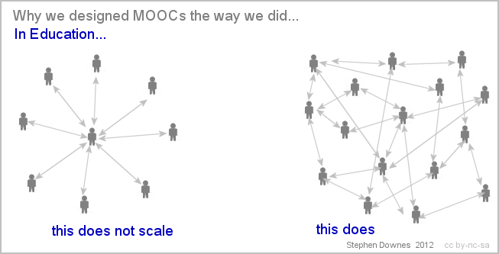
MOOCs
Notes:
The massive open online course (MOOC) phenomenon comes from connectivist theory. In a connectivist MOOC (cMOOC), it is open to anyone who wants to enroll, it uses open software and systems across the Web to facilitate learning and sharing, it takes place primarily online, and it happens according to a specified curriculum for a designated period of time. While facilitators guide the cMOOC, its participants are largely responsible for what they learn and what and how they share it; this connected behavior largely helps create the course content. https://www.learning-theories.com/connectivism-siemens-downes.html

Slide 75
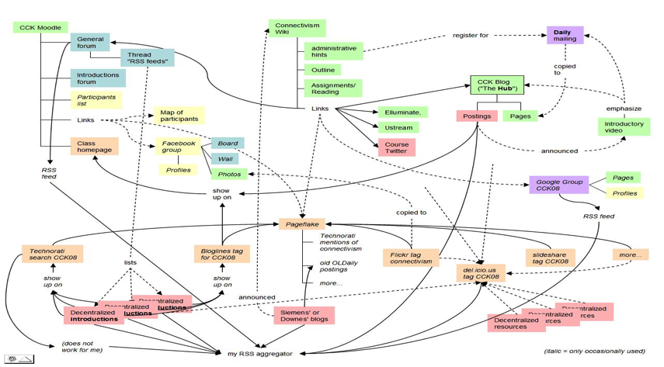
MOOCs (2)
Notes:
Connectivism: A Theory of Personal Learning
Stephen Downes, December 3, 2008, Educational Development Centre, Ottawa
http://www.downes.ca/presentation/208

Slide 76
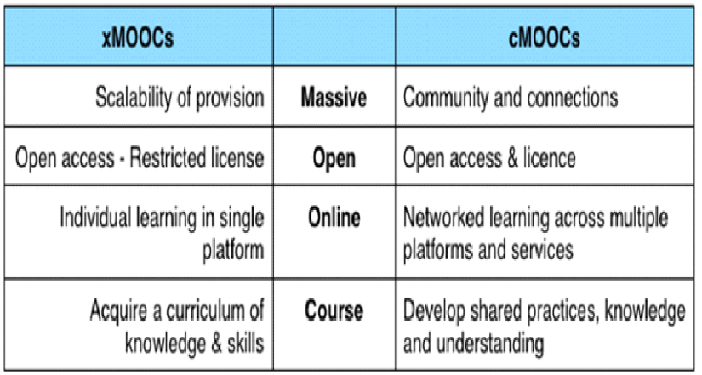
cMOOC vs xMOOC
Notes:
Image: https://sis.binus.ac.id/2019/02/06/what-are-the-differences-between-mooc-and-lms/

Slide 77
Classrooms
Profit (2019) examined connectivism as being utilized is in Active Learning Classrooms (ALC) but suggested that the theory would need to be modified
Montebello (2018) employs connectivism in the context of classroom interaction. Connectivism “justifies how learners employ networked resources, as potentially those within an AmI classroom.”
Notes:
Recent_Work_in_Connectivism.pdf

Slide 78
Microlearning
De Gagne et al. (2018) argue that “The theoretical basis of microlearning is connectivism”, because connectivism is focused on the development of the ability to form links between many ideas, each with each other and with different source of information.
“These connections between ideas in individual learners’ brains are formed, developed and maintained in what Siemens calls learning ecologies”, they write. “Learning ecologies can vary in size, scope and complexity, but they are all composed of networks of individuals and information Sources”.

Slide 79
Personalization
In the 'model' approach, personalization typically means more: more options, more choices, more types of tests, etc. You need to customize the environment (the learning) the fit the student.
In the 'connections' approach, personalization typically means less: fewer rules, fewer constraints. You need to grant the learner autonomy within the environment.
Notes:
https://www.downes.ca/post/38653

Slide 80
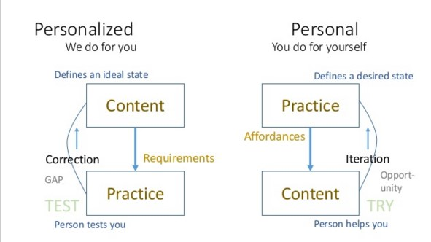
Personal Learning

Slide 81
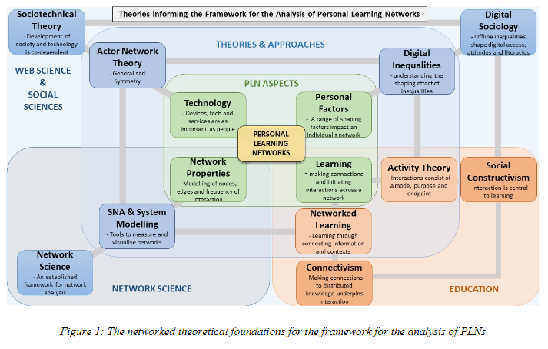
Personal Learning networks
Notes:
https://www.networkedlearning.aau.dk/digitalAssets/826/826395_16.-nicholas-s.-r.-fair---a-framework-for-the-analysis-of-personal-learning-networks---resubmitted-v2.pdf

Slide 82
Role of Connectivism
“It is important to reflect on concepts such as open education, open educational resources, connectivism and rhizomatic learning environments, given that these are themes that are articulated and strengthened due to the cyberculture.” (Zaduski, Lopes, & Schlunzen, 2018)
Connectivism also fosters critical thinking and deep learning, which educators see as essential moving forward.

Slide 83
Thinking of Connectivism More Widely
Its success isn’t measured in summative evaluations of pre-established learning objectives. Rather, it focuses on a wider understanding of learning and fosters a broad-based capacity to learn and adapt in dynamic and chaotic environments (Bowes & Swanwick, 2018).

Slide 84
Videos
Murmurations - https://www.youtube.com/watch?v=uV54oa0SyMc
Neural network animations - https://www.youtube.com/watch?v=3JQ3hYko51Y
3 of these things - https://www.youtube.com/watch?v=Ect-kgxBb4M – more complex - https://www.youtube.com/watch?v=gCxrkl2igGY
But also - https://www.youtube.com/watch?v=R1PgFShZ3z4

Slide 85
Networked Student – Wendy Drexler - https://www.youtube.com/watch?v=XwM4ieFOotA&t=309s
Overview of connectivism - Dr George Siemens - https://www.youtube.com/watch?v=yx5VHpaW8sQ
Metronomes - https://www.youtube.com/watch?v=T58lGKREubo

